Slide 1
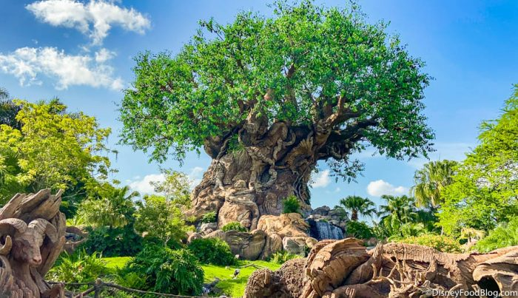
PROJECT ANIMAL KINGDOM

Slide 2


NARESH NARENDRAN UNU2200290 2023/01 ITWM5113 Software Design and Development Assignment 3

Slide 3
INTRODUCTION Animal Kingdom
Critter.java
CritterFrame.java
CritterInfo.java
CritterMain.java
CritterModel.java
CritterPanel.java
FlyTrap.java
Food.Java
Bear.java
Tiger.java
WhiteTiger.java
Giant.java
NinjaCat.java

Slide 4
DESCRIPTION
Critter – SUPERCLASS
5 class - Bear
- Tiger
- WhiteTiger
- Giant
- NinjaCat

Slide 5
DESCRIPTION
How should it behave ?
What hue is it ?
What string represents this animal ?
It defines the method.

Slide 6
DESIGN
Classes
Objects
Inheritance
Polymorphism
Encapsulation

Slide 7


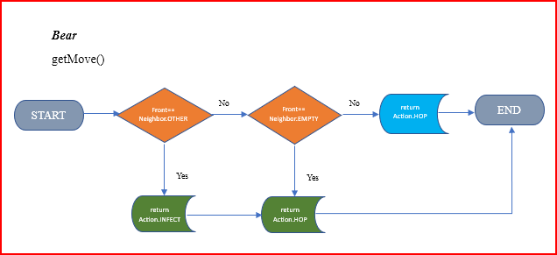
WORKFLOW & LOGIC

Slide 8
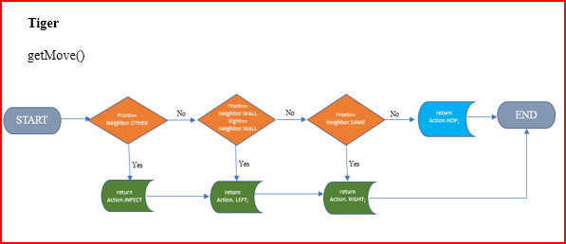
WORKFLOW & LOGIC

Slide 9
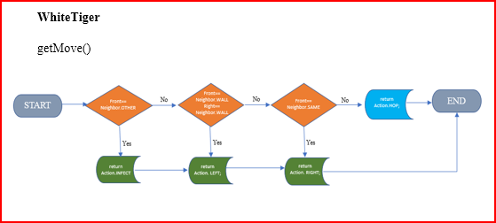
WORKFLOW & LOGIC

Slide 10
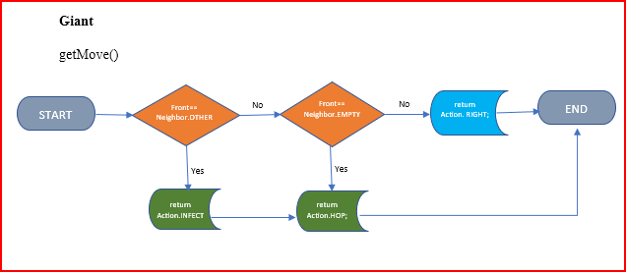
WORKFLOW & LOGIC

Slide 11
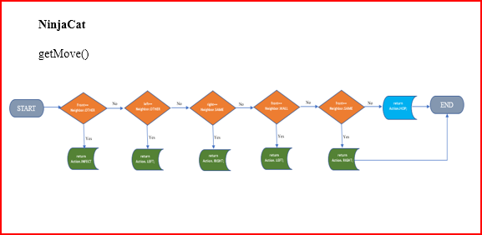
WORKFLOW & LOGIC

Slide 12
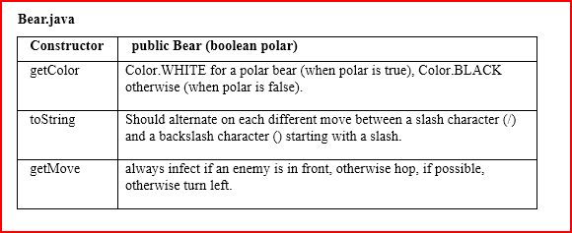
DEVELOPMENT

Slide 13
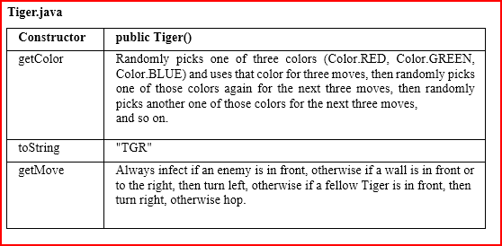
DEVELOPMENT

Slide 14
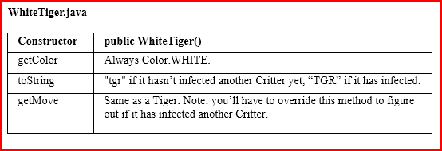
DEVELOPMENT

Slide 15
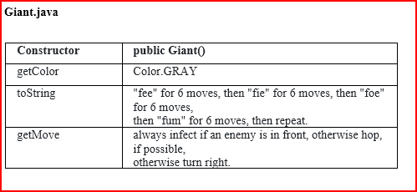
DEVELOPMENT

Slide 16
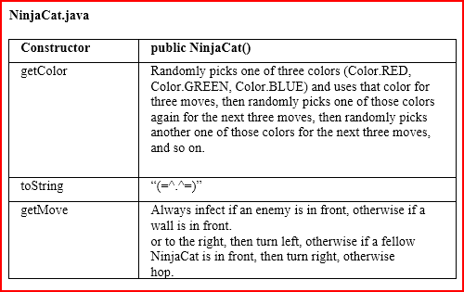
DEVELOPMENT

Slide 17
ANIMAL KINGDOM RUN

